Slide 1


Fraction of the Day
$$\frac{2}{5}$$
Then practice with these : $\frac{2}{3}+\frac{3}{3}$ and $\frac{3}{4}+\frac{1}{4}$
Notes:
Hook
Complete in left hand side

Slide 2
Lesson objective
By the end of this lesson you will be able to;
- Add and subtract fractions with unlike denominators
Notes:
Lesson

Slide 3
What did we learn during the last lesson?
How to add and subtract fractions when they have the same denominator
Today:
What if the fractions have a different denominator?

Slide 4
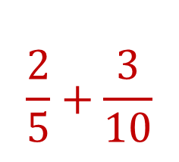
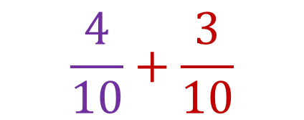


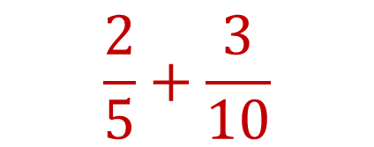
24
7
30
Date
Fractions
EQ – Describe how to add and subtract fractions with different denominators
Examples:
1st Step: Make the denominators the same
(using equivalent fractions!)
Whatever you do to the denominator you ALSO have to do to the numerator!
$$\frac{2}{5}+\frac{3}{10}$$
How to make the denominators the same?
$$\frac{2}{5}+\frac{3}{10}$$
$$2×$$
$$2×$$
$$\frac{4}{10}+\frac{3}{10}$$
5
Notes:
Lesson objective (EQ)

Slide 5
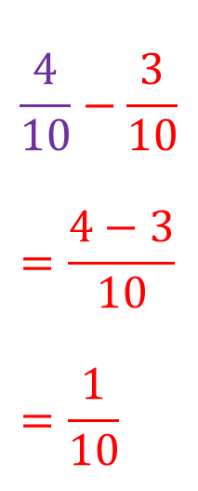
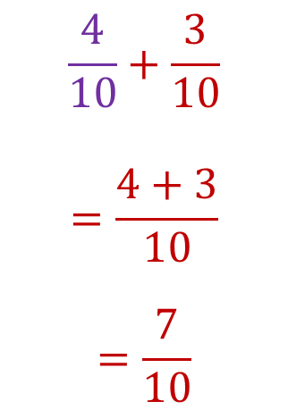
24
7
30
Date
Fractions
EQ – Describe how to add and subtract fractions with different denominators
Examples:
2nd Step:
When the denominator is the same add or subtract the numerators
3rd Step:
Then simplify your answer when possible.
$$\frac{4}{10}−\frac{3}{10} \\ =\frac{4−3}{10} \\ =\frac{1}{10}$$
What do we do when the denominators are the same?
$$\frac{4}{10}+\frac{3}{10}$$
$$=\frac{4+3}{10}$$
$$=\frac{7}{10}$$
5
Notes:
Lesson objective (EQ)

Slide 6

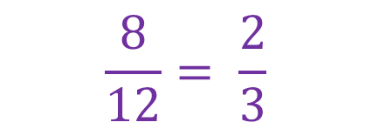
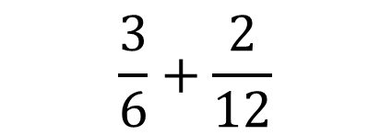
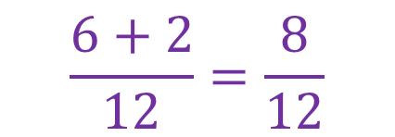
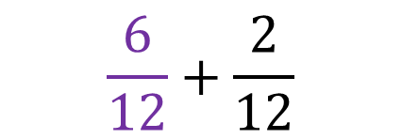

Whatever we do to the bottom we also need to do to the top!
Guided Practice: Task Side
How to make denominators the same?
$$2×$$
What number can we multiply by to get the same denominators?
$$\frac{3}{6}+\frac{2}{12}$$
$$2×$$
$$\frac{6}{12}+\frac{2}{12}$$
Now we just need to add the numerators!
$$\frac{6+2}{12}=\frac{8}{12}$$
Then simplify!
$$\frac{8}{12}= \frac{2}{3}$$

Slide 7

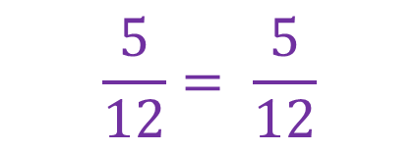
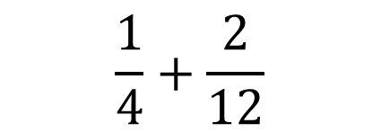
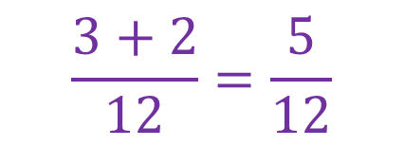
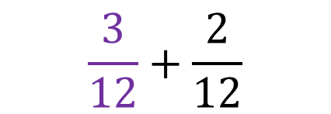

Whatever we do to the bottom we also need to do to the top!
Guided Practice: Task Side
How to make denominators the same?
$$3×$$
What number can we multiply by to get the same denominators?
$$\frac{1}{4}+\frac{2}{12}$$
$$3×$$
$$\frac{3}{12}+\frac{2}{12}$$
Now we just need to add the numerators!
$$\frac{3+2}{12}=\frac{5}{12}$$
Then simplify!
$$\frac{5}{12}= \frac{5}{12}$$

Slide 8




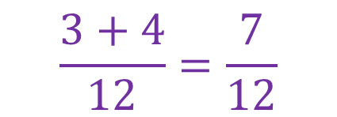
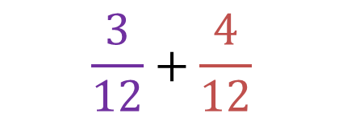


Whatever we do to the bottom we also need to do to the top!
Guided Practice: Task Side
How to make denominators the same?
$$3×$$
What number can we multiply by to get the same denominators?
$$\frac{1}{4}+\frac{2}{6}$$
$×$2
$$3×$$
$×$ 2
Sometimes you have to multiply both fractions!
$$\frac{3}{12}+\frac{4}{12}$$
Now we just need to add the numerators!
$$\frac{3+4}{12}=\frac{7}{12}$$
Then simplify!
$$\frac{7}{12}$$

Slide 9


Independent Practice
$\frac{3}{4}+\frac{5}{8}$
$\frac{1}{2}+\frac{2}{5}$
$\frac{4}{5}+\frac{1}{3}$
Sometimes you have to multiply both fractions!

Slide 10

Go back through your fractions of the day and complete the add it sections!
Complete your summary

